Slide 1
Preliminary Design Review
Ukpik-1 Team
CCP-WAC-PDR-PPT1
PI: Jayshri Sabarinathan
PM: Matt Cross

Slide 2
Mission Overview
Presented by Matt Cross

Slide 3
Preface
Suffering from Success in Space!
Assistant PM Matt Bourassa takes job at SED
Systems team members Bryan, Alexis, Kelsey have internships at JPL
Matt, Kelsey, Alexis, Chimira on LEAD science campaign
Kelsey teaches short course at Paris Observatory, Chimira attends
Alexis and Stephen have successful STRATOS balloon campaign
Matt, Alexis, Lauren on LEAD cap-demo
High turnover with Capstone projects
Students that have contributed to the preliminary design have moved on
New capstone students just getting started on detailed design

Slide 4
Preface
We acknowledge that gaps exist, and we will work towards filling those gaps

Slide 5
Mission Objectives
The primary objective of Ukpik-1 is to provide experiential learning and training opportunities for students in spacecraft development and operations, and in STEM outreach program development and delivery.
The secondary objective is to integrate and operate an immersive VR camera in orbit for science and education.

Slide 6
Requirements Nomenclature
“Must” denotes an externally imposed requirement
“Shall” denotes an internally imposed requirement subject to internal change
“May” denotes a goal requirement

Slide 7
Mission Requirements
ID | Programmatic Requirements
MR-PR01 | The CubeSat program shall provide experiential learning opportunities in spacecraft systems throughout the project life
MR-PR02 | The CubeSat program shall support educational outreach program development and delivery
MR-PR03 | The CubeSat program shall comply with Western University’s health and safety standards
MR-PR04 | Must conform to CSA AIT HS guidelines
MR-PR05 | The CubeSat program must comply with the Canadian CubeSat Project Guidelines as outlined by the Canadian Space Agency
MR-PR06 | The CubeSat program must comply with the project schedule as specified by the Canadian Space Agency
MR-PR07 | The CubeSat program must comply with the launch requirements as set by the launch provider
MR-PR08 | The CubeSat program must comply with ground safety requirements as set by the launch provider
MR-PR09 | The CubeSat program shall facilitate student engagement with the Nunavut Arctic College on the CubeSat project

Slide 8
Mission Requirements
ID | Science and Outreach Requirements
MR-SC01 | The CubeSat shall integrate an immersive VR camera as a primary science and outreach payload
MR-SC02 | The CubeSat may integrate an accelerometer as a secondary payload for space weather events as a goal
MR-SC03 | The CubeSat shall acquire and return to ground at minimum 5 images of either scientific or outreach interest from the VR camera
MR-SC04 | The CubeSat may solicit public input for image target selection as a goal
MR-SC05 | The acquired VR images shall be made publicly available
MR-SC06 | The acquired VR images and video shall me viewable with an Oculus Rift
MR-SC07 | The acquired VR images may be viewable with other VR headsets as a goal
MR-SC08 | The CubeSat may acquire images at a rate of 5 per week as a goal
MR-SC09 | The CubeSat may acquire 1 VR video as a goal
MR-SC10 | The CubeSat may image the moon as a goal
MR-SC11 | The CubeSat may image the Northern Canada as a goal
MR-SC12 | The CubeSat may image the limb of the Earth as a goal
MR-SC13 | The CubeSat may image the atmosphere as a goal

Slide 9
Mission Requirements
ID | Operational Requirements
MR-OP01 | The CubeSat must operate in a Low Earth Orbit as determined by the launch provider
MR-OP02 | The CubeSat shall be primarily operated by Western University students
MR-OP03 | The CubeSat may be operated remotely through an internet-based operations console
MR-OP04 | The CubeSat shall operate for a baseline mission of 6 months
MR-OP05 | The CubeSat may operate for more than 6 months as a goal
MR-OP06 | The CubeSat must adhere to Nanoracks BOL LEOP requirements
MR-OP07 | The CubeSat may turn on camera upon deployment from ISS as a goal
MR-OP08 | The CubeSat must comply with EOL requirements
MR-OP09 | The CubeSat must comply with communications licensing policies
MR-OP10 | The CubeSat must comply with remote sensing licensing policies
MR-OP11 | The CubeSat must conform to Controlled Goods licensing
MR-OP12 | The ground station must have the proper licensing
MR-OP13 | The CubeSat shall utilize available ground station infrastructure
MR-OP14 | The CubeSat shall log telemetry for mission operators

Slide 10
Spacecraft Operational Modes
Mode | Transitions From | Description | Transitions To
Launch |  | All systems remain off | Deployment Mode
Deployment | Launch Mode | Triggered by deployment switches; initiates 30 minute timer | Safe Mode
Safe | Any | Reboots on board computer | Detumble
Detumble | Safe | Identifies current rotation rate and then reduces rate to point solar panels towards sun | Nominal, Safe
Nominal | Detumble, Imaging, Transmission, Eclipse | Controlled attitude, charging batteries, processing time-tagged queue | Imaging, Transmission, Eclipse, Safe
Imaging | Nominal | Switches on cameras, takes images as requested, facilitates data transfer from camera memory to OBC, draws power from battery | Nominal, Safe
Transmission | Nominal | Draws power from battery to transmit to ground | Nominal, Safe
Eclipse | Nominal | Reduced power consumption, draws power from battery | Nominal, Safe

Slide 11
Concept of Operations
1 Primary ground station (London area)
~7 ground station passes
Receive TM and Images at every opportunity
Send time-tagged queue of TC
Secondary GS for receiving (as available)
Remote Mission Control to permit operations ‘in the classroom’
Immersive image display for public outreach

Slide 12
Concept of Operations
Capture images of deployment from ISS (if permitted)
Solicit imaging requests from public, with priority to Nunavut Arctic College requests
Generate 7-day time tagged queue of TC, updated daily
Onboard image quality assessment, downlink low-res thumbnails
Downlink higher-quality images

Slide 13
System Requirements – Payload
 | Payload Requirements
SY-PA01 | The VR cameras shall have a bill of materials to provide the launch provider
SY-PA02 | The VR cameras may switch on upon deployment from ISS as a goal
SY-PA03 | The VR cameras shall be operable on a time-tagged queue
SY-PA04 | One image shall be two semi-spherical images stitched together on the ground
SY-PA05 | The CubeSat shall integrate an Inuit engraving

Slide 14
Inuit Engraving
Requirement to provide mass and volume allocation, and mounting bracket for an Inuit engraving supplied by Nunavut Arctic College students
Intention is for NAC to utilize material sourced from Nunavut
Initiates Fall 2019

Slide 15
Systems Engineering
Presented by Nick Mitchell

Slide 16
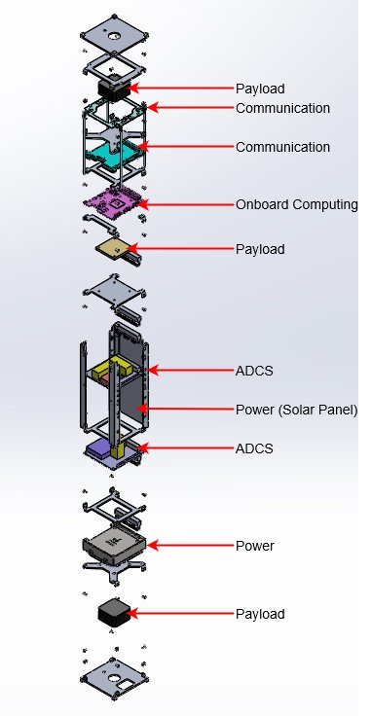
Internal Hardware Layout

Slide 17
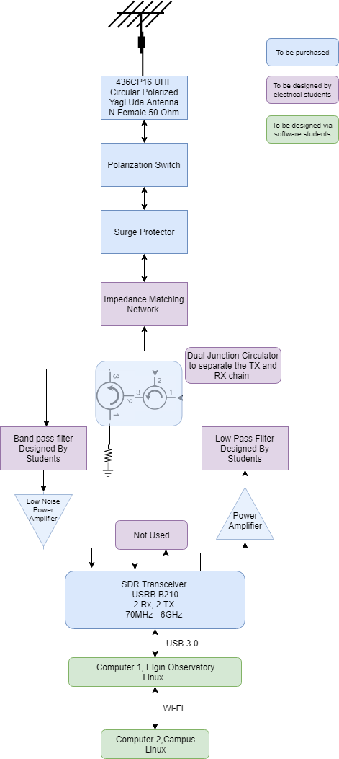
Space to Ground Interfaces

Slide 18
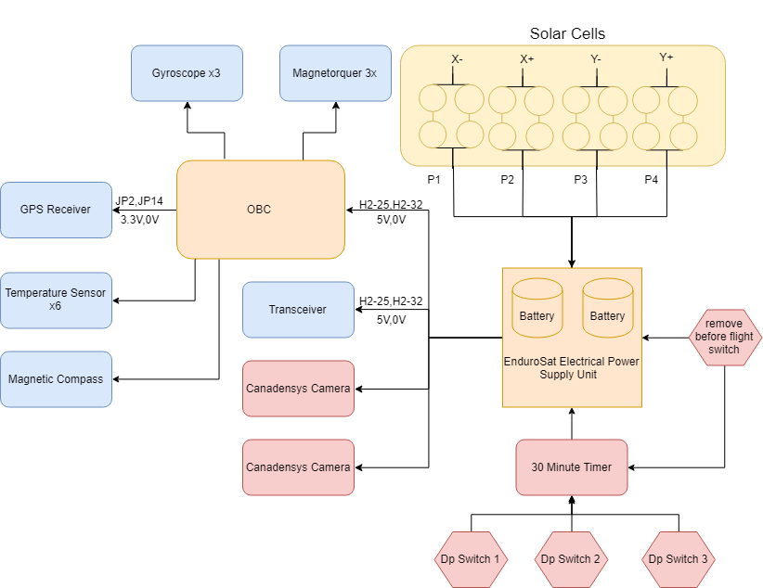
Power Interfaces

Slide 19
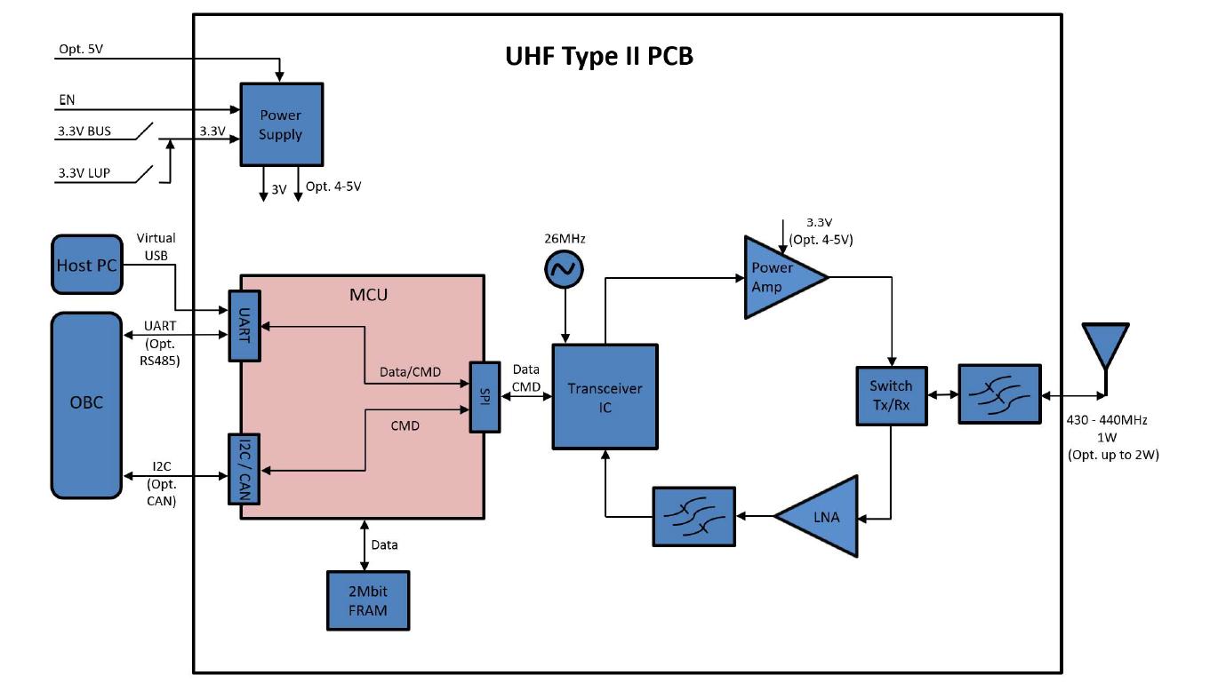
Communications Interfaces

Slide 20
System Requirements (Overview)
ID | Space Segment Requirements
SY-SS01 | The CubeSat shall be a 2U form factor
SY-SS02 | The CubeSat must comply with NanoRacks deployment specifications
SY-SS03 | The CubeSat must have a remove before flight pin
SY-SS04 | The CubeSat must have deployment switches
SY-SS05 | The CubeSat must have a 30-minute timer circuit
SY-SS06 | The CubeSat must provide a bill-of-materials to NanoRacks
SY-SS07 | The CubeSat must comply with outgassing specifications
SY-SS08 | The CubeSat shall receive and execute time-tagged telecommands
SY-SS09 | The CubeSat shall transmit time-tagged telemetry
SY-SS10 | The CubeSat shall determine its pose
SY-SS11 | The CubeSat shall control its pose
SY-SS12 | The CubeSat shall determine its orbital position
SY-SS13 | The CubeSat shall provide enough power to operate all mission modes throughout its mission life
SY-SS14 | The CubeSat shall survive the test environment
SY-SS15 | The CubeSat shall survive the integration environment
SY-SS16 | The CubeSat shall survive the launch environment
SY-SS17 | The CubeSat shall survive the low earth orbit thermal environment
SY-SS18 | The CubeSat shall survive the low earth orbit radiation environment
SY-SS19 | The CubeSat shall facilitate integration of two Canadensys NISA cameras
SY-SS20 | The CubeSat shall facilitate transmission of images from the camera to the ground
SY-SS21 | The CubeSat shall safely re-enter atmosphere and burn up
SY-SS22 | The CubeSat must have a launch mass less that 3.6kg
SY-SS23 | The CubeSat shall be operated in a LEOP & Checkout phase and a nominal phase
SY-SS24 | The CubeSat and its components shall be designed and manufactured to meet system requirements for a minimum operational lifespan of 6 months
SY-SS25 | The CubeSat components shall be designed or selected to prevent undesired electromagnetic effects

Slide 21
System Requirements (Overview)
SY-SS26 | The CubeSat shall always be in one of the following operations: Launch Mode; Deployment Mode; Detumble Mode; Safe Mode; Eclipse Mode; Communications Mode; Imaging Mode; and Nominal Mode
SY-SS27 | The CubeSat shall be delivered to the launch provider in Launch Mode
SY-SS28 | The CubeSat shall exit Launch Mode into Deployment mode upon deployment from ISS
SY-SS29 | The CubeSat transition to Deployment Mode shall trigger a 30 minute timer.
SY-SS30 | The VR cameras may switch on to begin imagining during Deployment Mode as a goal
SY-SS31 | The CubeSat shall deploy its antenna following the 30 minute delay
SY-SS32 | The CubeSat shall bootup the OBC during Deployment Mode
SY-SS33 | The CubeSat shall exist Deployment Mode into Detumble Mode following the antenna deployment
SY-SS34 | The CubeSat shall minimize its initial rotation rates during Detumble Mode
SY-SS35 | The CubeSat shall control its pose to face its solar panels towards the sun during Detumble Mode
SY-SS36 | The CubeSat shall respond to TC with TM during Detumble Mode
SY-SS37 | The CubeSat shall exit Detumble Mode into Nominal Mode through TC
SY-SS38 | The CubeSat shall enter Safe Mode either through TC or through detection of an onboard anomaly
SY-SS39 | The CubeSat shall exit Safe Mode into Detumble Mode through TC
SY-SS40 | The CubeSat shall enter Imagining Mode through time-tagged TC
SY-SS41 | The CubeSat shall exit Imaging Mode into Nominal Mode through time-tagged TC
SY-SS42 | The CubeSat shall enter Communications Mode through time-tagged TC
SY-SS43 | The CubeSat shall exit Communications Mode into Nominal Mode through time-tagged TC
SY-SS44 | The CubeSat shall enter Eclipse Mode either automatically or through time-tagged TC
SY-SS45 | The CubeSat shall exit Eclipse Mode into Nominal Mode either automatically or through time-tagged TC
SY-SS46 | The CubeSat shall function autonomously for a maximum of 7 days without intervention from MC
SY-SS47 | The CubeSat shall detect onbaord anomalies
SY-SS48 | The CubeSat shall provide pointing accuracy of 15 degrees for the solar panel aligned with the normal to the sun vector
SY-SS49 | The CubeSat shall have a centre of mass within 2cm of the of centre of volume
SY-SS50 | The CubeSat configuration shall be such that no unit be subjected to loading beyond the limits stated in its specification
SY-SS51 | The CubeSat shall store up to 10 days of housekeeping data as a minimum
SY-SS52 | The CubeSat flight software shall be reprogrammable in orbit
SY-SS53 | The CubeSat power system shall be sized for an expected EOL of 12 months
SY-SS54 | The CubeSat system shall be designed for ground-based testability
SY-SS55 | The CubeSat system shall be designed with ease of assembly and integration in mind

Slide 22
Single Point Failures
Deployment switches don’t activate timer and CubeSat never switches on
OBC does not boot properly

Slide 23
Single Point Impediments
Antennae do not deploy fully resulting in reduced gain; can possibly still downlink 5 images
Magnetorquers fail; communications or imaging do not require pointing, reduced power generation for battery charging reduces transmission of images

Slide 24
Communications Systems
Work done by Nick Mitchell, Kelsey Doerksen, 2018/2019 Capstone Teams
Work presented by Nick Mitchell

Slide 25
Communications Systems
Data handling protocols
Data Downlinking Strategy
TT&C Data Volume
Payload Operation
Hardware
Radiation Pattern Analysis
Link Budget
Frequency Licensing Status

Slide 26
Communications Subsystems
EnduroSat type II transceiver data handling protocols:
Information | Transparent | AX.25
Maximum Information per payload (bytes) | 128 | 97
Minimum Information per payload (bytes) | 9 | 4
FEC correction | CRC | None
Overhead | Low | High
Standardization | No | Yes
ARQ | Yes | Yes
Notes:
ARQ = Automatic Repeat Request
FEC = Forward Error Correction

Slide 27
Communications Subsystems
For multiple ground stations and being flexible for other teams, AX.25 was chosen.
Information | Transparent | AX.25
Maximum Information per payload (bytes) | 128 | 97
Minimum Information per payload (bytes) | 9 | 4
FEC correction | CRC | None
Overhead | Low | High
Standardization | No | Yes
ARQ | Yes | Yes
Notes:
ARQ = Automatic Repeat Request
FEC = Forward Error Correction

Slide 28
Communications Systems
Operation:
Endurosat type II transceiver, Half duplex
Protocol:
AX.25
Modulo 8 implementation
7 Information frames before an acknowledge frame
Information field: 776 bits of information (84.35%)
Overhead: 144 bits (15.65%)

Slide 29
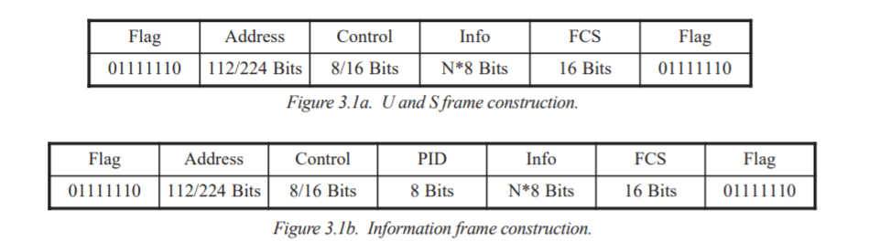
Communications Systems
Network Layer Protocol (PID):
Not implemented
Address:
Determined by callsigns
Notes:
https://www.tapr.org/pdf/AX25.2.2.pdf image taken from

Slide 30
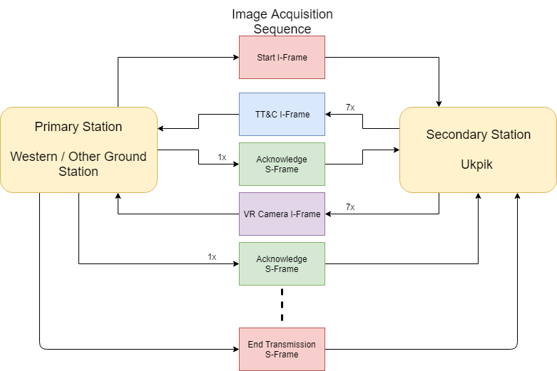
Communications Systems
Notes:
Update name to Ukpik / add title of image acquisition Communication

Slide 31
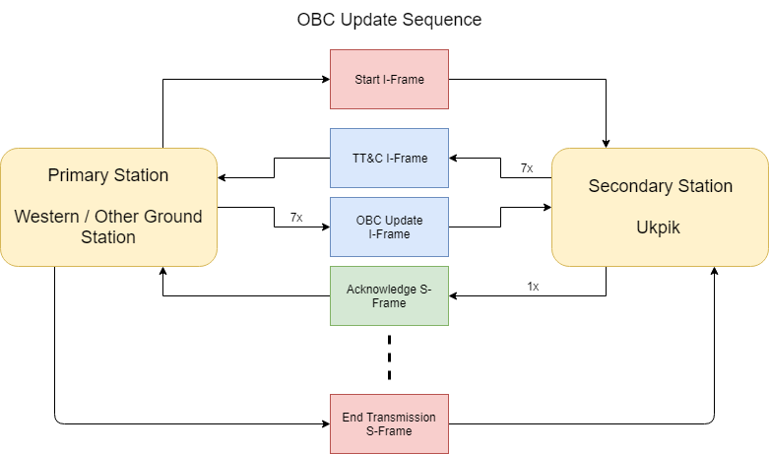
Communications Systems

Slide 32
Communications Systems
Start I-Frame:
Command for current transmission, maximum end transmission time ,Next time to transmit
Next groundstation callsign
Commands
Send image thumbnails, send specific image, apply OBC patch, capture image
Extreme case:
Built in information frame for stop all transmission IMMEDIATELY.

Slide 33
Communications Systems
TT&C I-Frame:
First packet sent back by CubeSat
Contains the following sensor information:
OBC time
GPS coordinates
Sun Sensor Voltage + Currents
Battery voltages
Temperature Sensors
Solar Panel voltages
Magnetorquer current/voltage sensor
Magnetic compass sensor
Notes:
Time permitting go and check all the data yourself
Capture rate = 1 min
Sensors per 1 reading
General data ask vidushi

Slide 34
Communications Systems
Acknowledge S-Frame (ARQ):
Acknowledge send next frame
Acknowledge do not send next frame
Selective Reject a frame for retransmission
Reject all frames, retransmit all

Slide 35
Communications Systems
Taccess = Tstart_link + Tend_link + Tinformation
$Taccess = Tstart + Tend +2∗Tprop +2Tproc + N∗(Tcubeproc+Tgroundproc+Tack+7∗Tinfo+2Tprop)$
Uplink data rate = 1200bps
Downlink data rate = 9600bps
Where Tproc = process time ~50ms

Slide 36
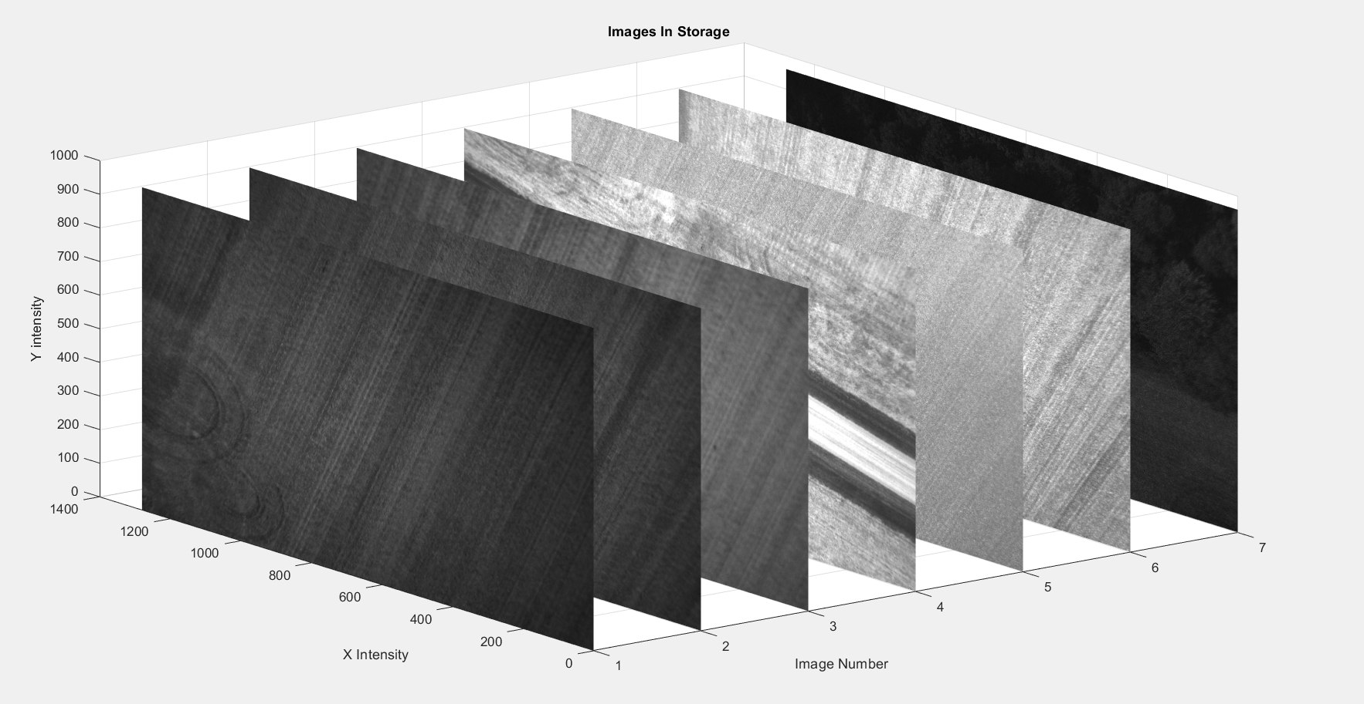
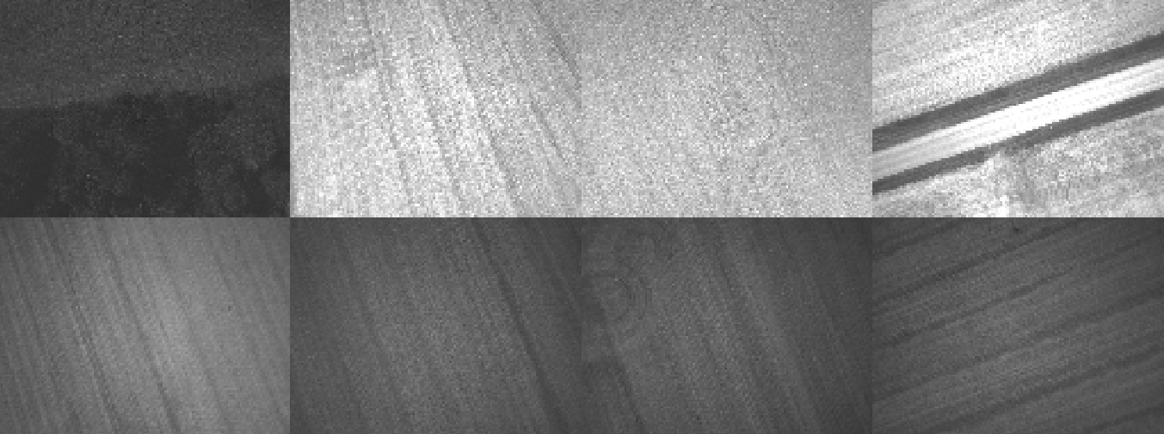
Communications Systems
VR Camera I-Frame
Payload Operation
Secondary provides thumbnail format for lower quality image to select
Selection of full image via command by primary

Slide 37
Communications Systems
Image provided by camera:
Initial:
Images captured in 12 bit JPEG
3000 x 3000 pixels per image
13.5MB per image
Compressed:
Up to 15x compression
<1MB per image

Slide 38
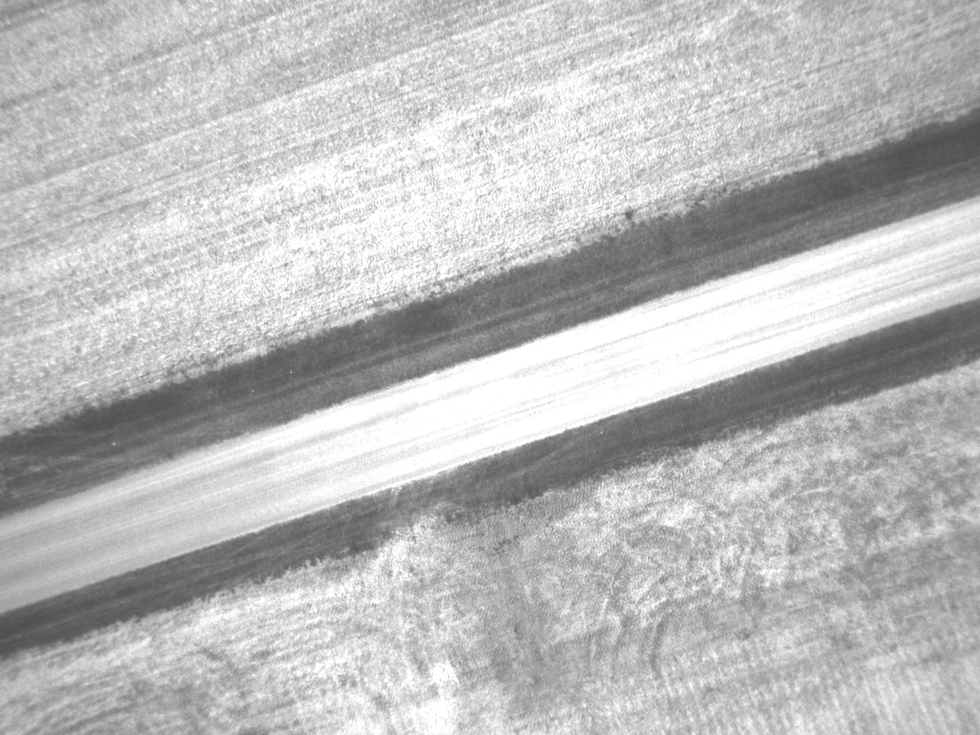
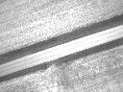
Communications Systems
Thumbnail generation:
Bit depth: 12 bit → 8 bit jpeg
Reduce number of columns/rows by a factor (0.1)
12 bit jpeg, 1941 kB, FOV = 47$°$
8 bit jpg, 4kB, FOV = 47$°$

Slide 39
Communications Systems
Hardware:
Ukpik 1 Transceiver:
Endurosat Type II UHF transceiver
GMSK + FSK modulation
Data rate: 1.2 kbps - 19.2kbps
Half duplex
Frequency range: 430-440MHz
Output Power: 1W
Noise Figure (LNA + filter insertion loss): 1.5dB

Slide 40
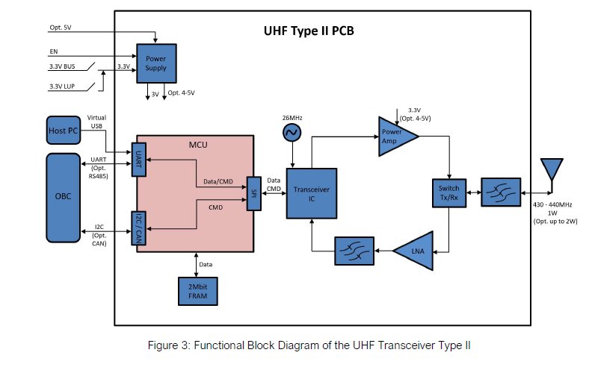
Communications Systems

Slide 41
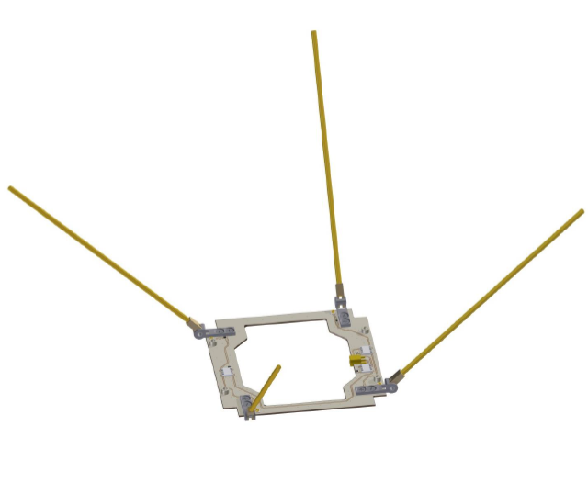
Communications Systems
Hardware:
Ukpik 1 Antenna:
GOMspace 70 cm band Omnidirectional UHF CubeSat antenna
Frequency range: 435$±5MHz$
LCHP forwards, RHCP backwards
Peak gain 1.6dBi
50 $Ω input impedance$
30 g weight

Slide 42
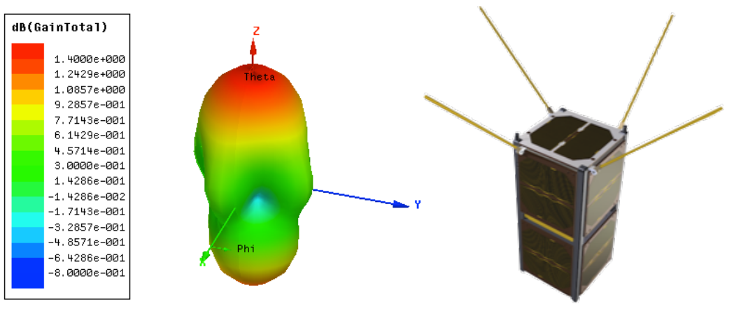
Communications Systems
Radiation Pattern Analysis:
Information from GOMspace datasheet at 45$°$

Slide 43
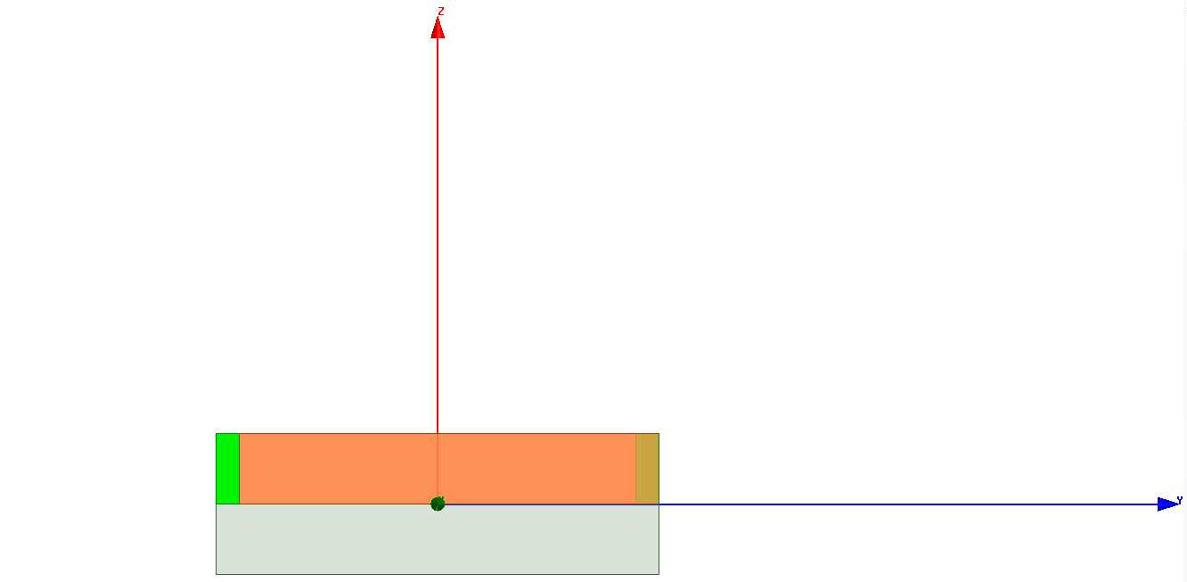
Communications Systems
Work done by Kelsey Doerkson:
Additional information:
Will be referring to monopole orientations in positive angle offsets.
Referencing the substrate below
Datum

Slide 44
Communications Systems
More information:
45 degree offset of my model is more omnidirectional than ANT430 model from GOMspace
The model makes an assumption of using perfect conductors for the monopoles
Next steps: Add in the CubeSat structure to see the effects on the radiation pattern
Bending was not done because it is unrealistic in ANSYS HFSS. Hands on testing more suitable

Slide 45
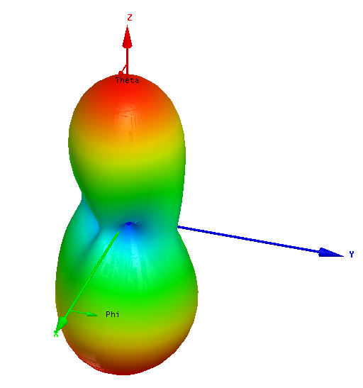
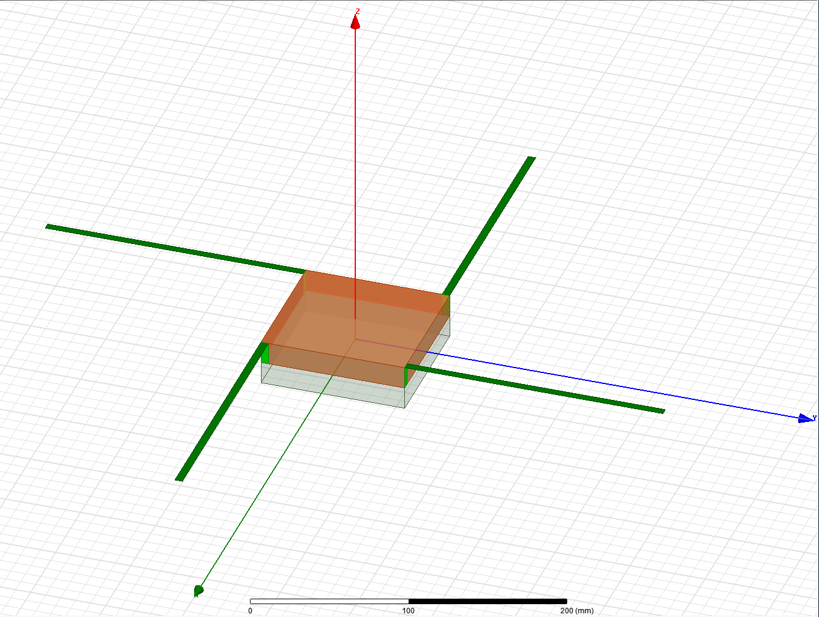
Communications Systems
0 degrees:
Max gain: 3.9 dB
Min gain: -0.006dB

Slide 46
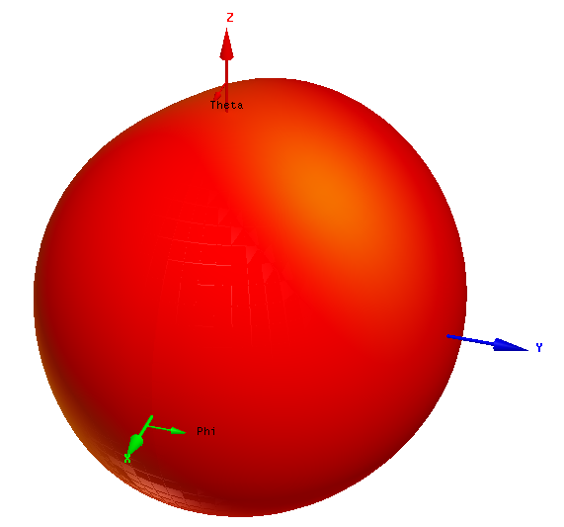
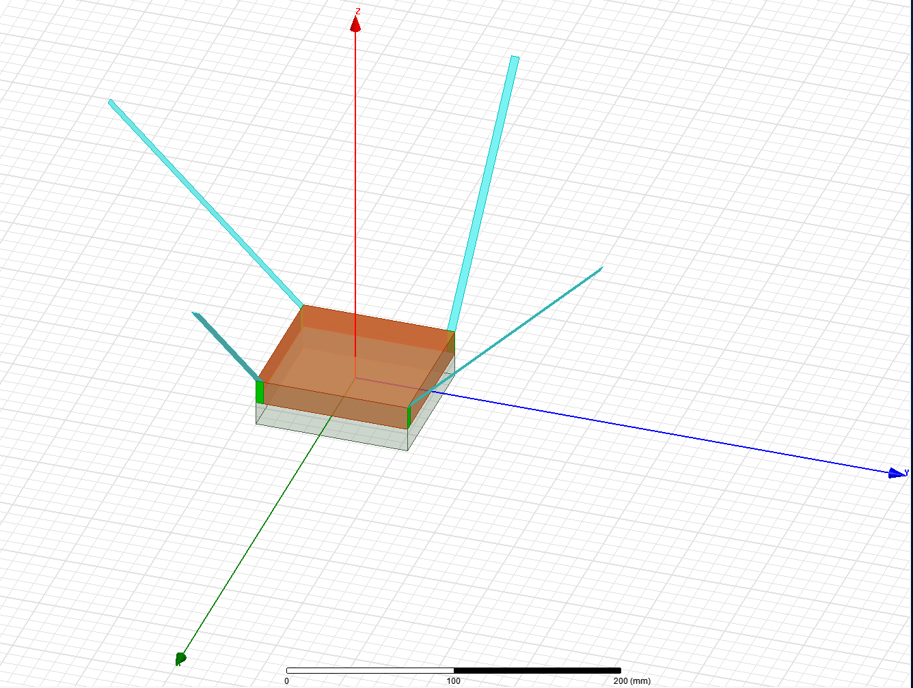
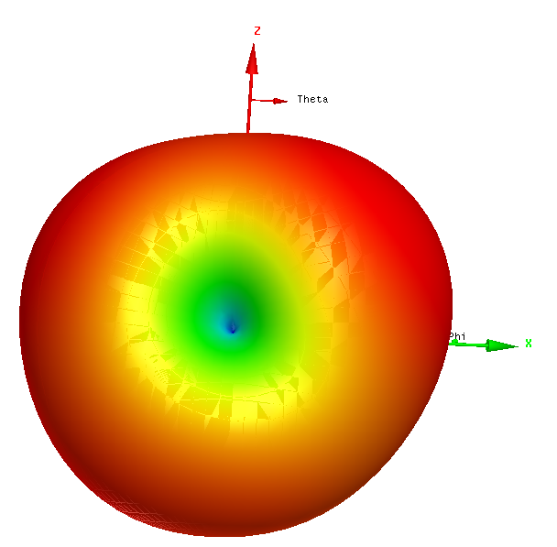
Communications Systems
45 degrees:
Max gain: 2.2 dB
Min gain: -9.05dB

Slide 47
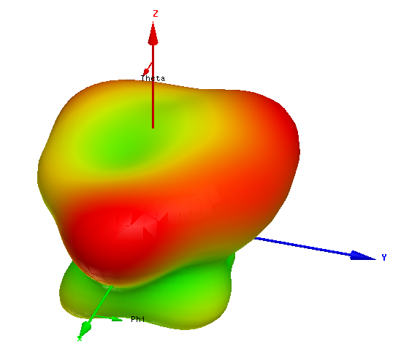
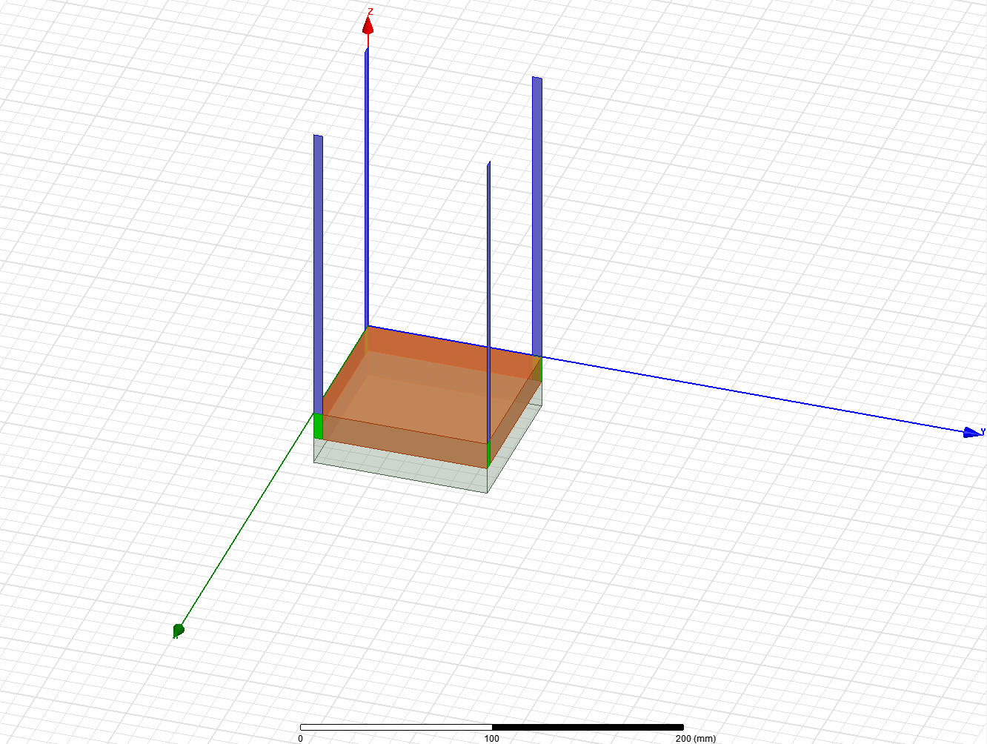
Communications Systems
90 degrees:
Max gain: 0.23dB
Min gain: -0.007dB

Slide 48
Communications Systems
Summary Chart for all monopole offsets simulated:
Monopole Offset (Degrees) | Maximum Gain (dB)
0 | 3.90
10 | 3.37
20 | 3.23
30 | 3.07
40 | 2.89
45 | 2.20
50 | 2.15
60 | 1.69
70 | 1.28
80 | 0.74
90 | 0.23

Slide 49
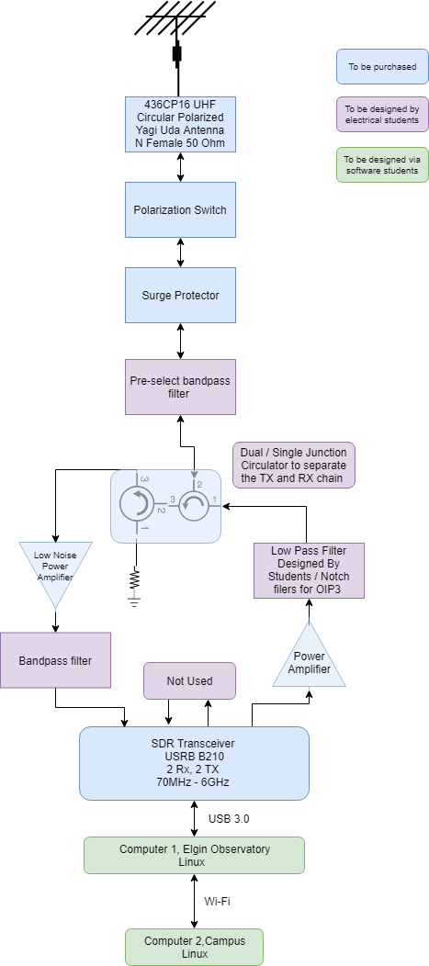
Communications Systems
Groundstation Block Diagram
Important Design Choices still:
Filter design by capstone students
Power amplifier gain
Driven by: Third harmonic Output
SDR transceiver specs.
Etus USRB B210
Link budget Output power need

Slide 50
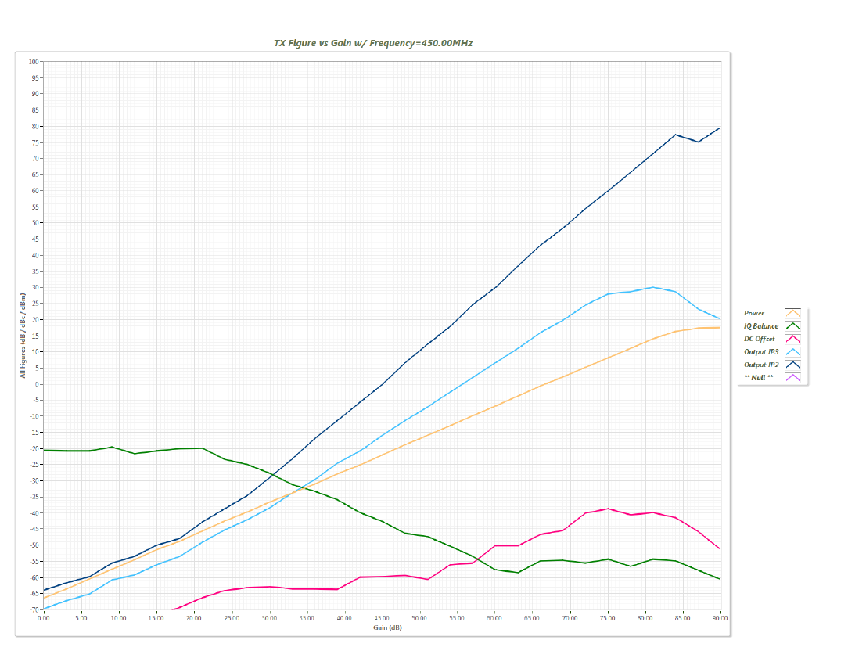
Communications Systems
Tight filtering needed
Moderate filtering needed

Slide 51
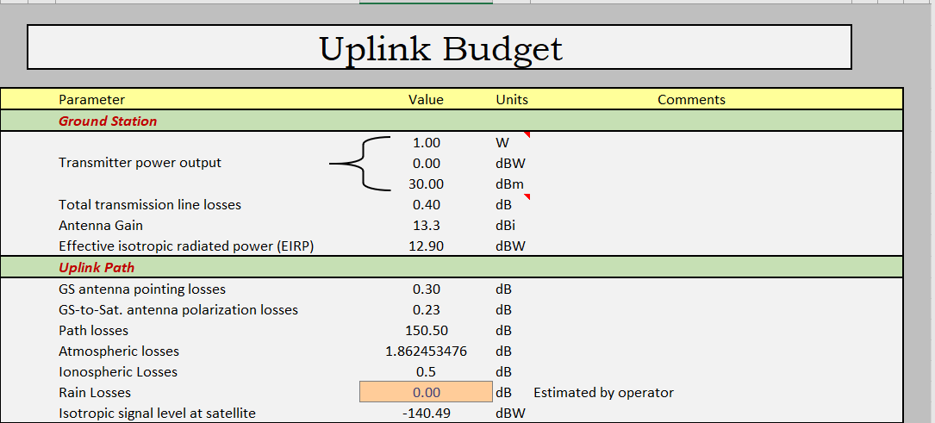
Communications Systems
Link Budget:

Slide 52
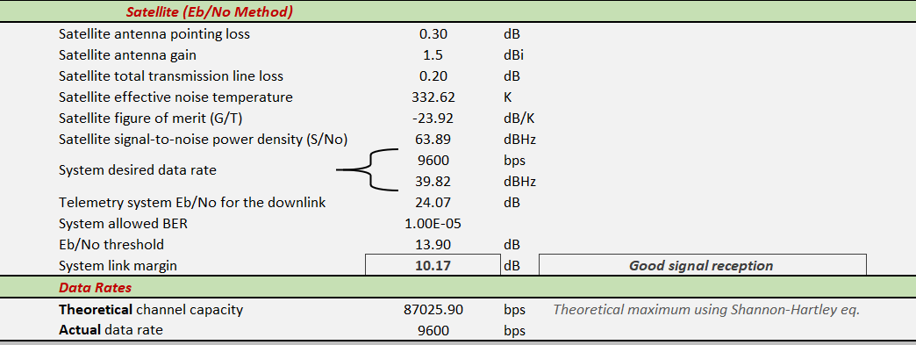
Communications Systems

Slide 53
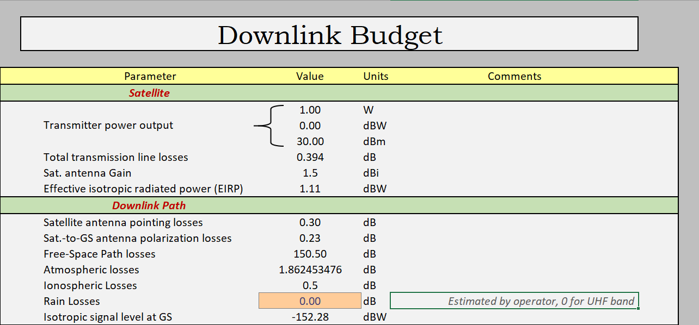
Communications Systems

Slide 54
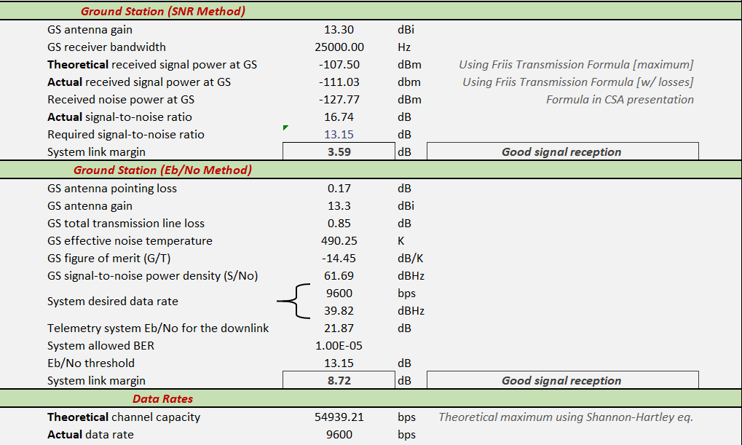
Communications Systems

Slide 55
Communications Systems
Uplink Eb/No method chosen because SNR method has lacking information at this point of time.
Advice from Peter Kazakoff + outlined issues of Link Budget from July 31st 2019.
Separating TX & RX when building ground station block diagram.
Scaled back power from transmitter on earth
Antenna noise temperature
Adjusted CubeSat Noise temperature to gain-weighted average using ITU recommendations.

Slide 56
Communications Systems
Antenna Noise Temperature:
Ground station antenna still needs to be looked at. Conservative value of 530k chosen.
Cable loss was too high before, this has been scaled back to 0.85dB based on LM400 and 9m length.
Filter insertion losses added as an estimate 1 dB was added
Polarization switch was added in case of ADCS failure.

Slide 57
Communications Systems
Frequency Licensing:
Dr. Jayshri Sabarinathan and Nicholas Mitchell will be getting their amateur radio licenses.
Required for RAC endorsement application
Has been started but not completed
Required for IARU satellite coordination request
Has been started but not completed
It is acknowledged that this will be the highest priority once PDR is over.

Slide 58
Mechanical System
Work done by Claire Lizotte, 2018/2019 Capstone Teams
Work Presented by Bryan Southwell
Notes:
Antenna release on the solar panels

Slide 59
Mass Budget Margin Philosophy
10% Off the Shelf
15% Modified off the shelf
20% Custom Build
20% Supplier not determined

Slide 60
Mass Budget
Subsystem | Mass (g) | Margin | Mass w/ Margin (g)
Mechanical
Structure | 1064 | ~17% | 1246
Thermal | 50 | 20% | 60
Deployment | 25 | 20% | 30
Electrical
EPS w/ Battery | 292 | 10%
Solar Panels | 388 | ~14% | 441
Custom Boards | 352 | ~17% | 409
ADCS | 140 | ~18% | 165
OBC | 56 | 10% | 64
COMMS | 178 | ~12% | 200
NISA Cameras | 300 | 10% | 330
Engraving | 150 | 20% | 180
TOTAL | 2997 | ~15% | 3446

Slide 61
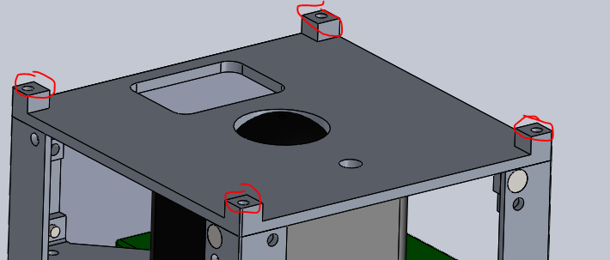
Deployment Mechanisms
Holes for plunger switches
Have not yet identified source for plunger switches

Slide 62
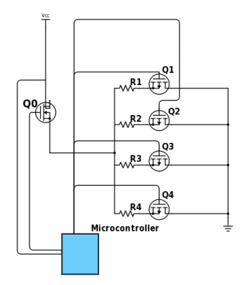
Deployment Mechanisms
Burn wire for antennae

Slide 63
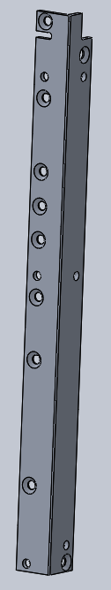
Revised CubeSat Structure From MCR
Structure redesigned from the rails in
Each rail is similar yet unique to accommodated various components

Slide 64
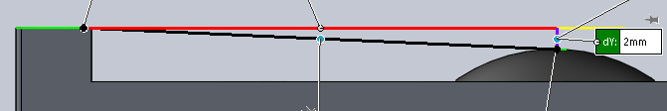
Revised Structure: Cover Plates
Separate parts from rails; bolted to rails
Relation between rail ends and top of camera lens. There must be at least 2 mm, as specified by Nanoracks.

Slide 65
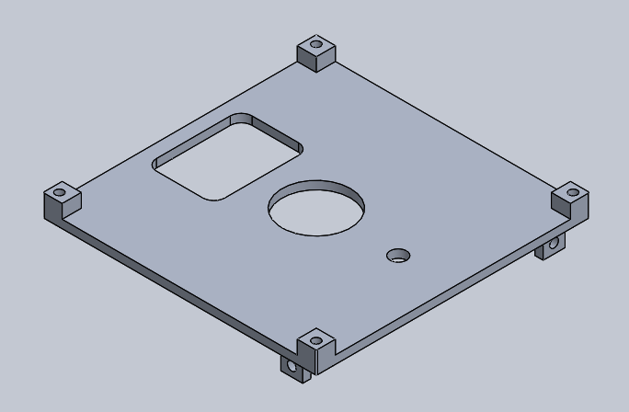
Revised Structure: Cover Plates
Cover plate with allowance for GPS antenna

Slide 66
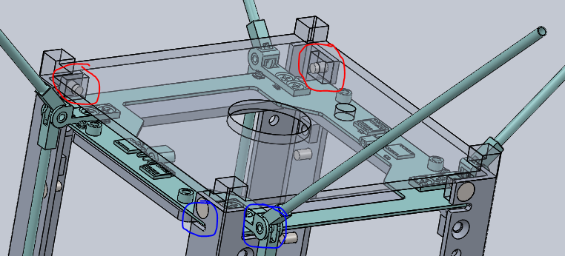
Revised Structure: Antenna, Rails and Cover Plate
The cover plate is transparent. The blue circles show where the antenna slots into the rails. The red circles show that the tabs that hold the cover plate onto the rails are on the opposite side of the corners from the antenna itself.

Slide 67
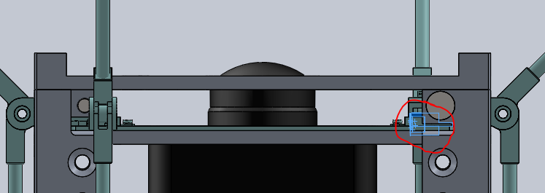
Revised Structure: Antenna, Camera and Cover Plate
The antenna has a coaxial cable that plugs in where the red circle is.

Slide 68
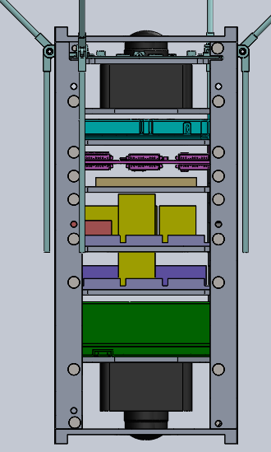
Revised Configuration
Black = camera
Turquoise = antenna
Light blue = transceiver
Pink = OBC
Tan = NAC engraving
Yellow = magnetorquers
Red = gyroscope
Light purple = custom board
Purple = GPS transceiver
Green = EPS with battery

Slide 69
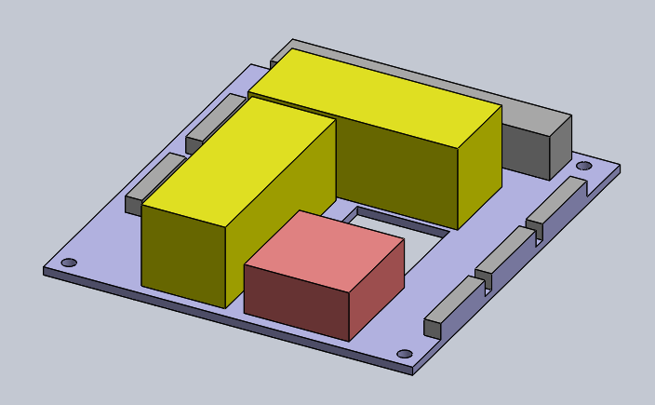
Revised Configuration: Custom Board 1
Magnetorquers are yellow. Connectors grey. Gyroscope block is red.

Slide 70
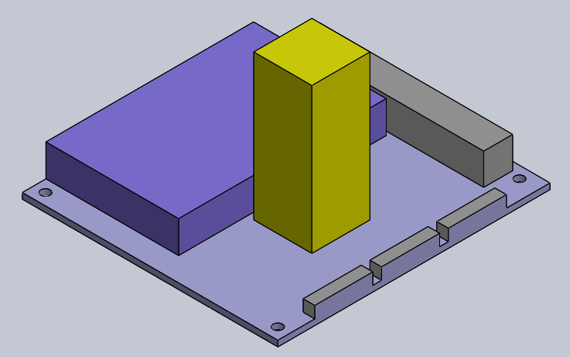
Revised Configuration: Custom Board 2
The magnetorquer is yellow. The GPS transceiver is darker purple. the board is light purple. The connectors are grey.

Slide 71
Manufacturing Strategy
Component | Manufacturing Method | Reasoning
Mounting Plates | Laser cut, then sheet metal bending | It is easier and quicker to laser cut the thin material
Rails | Milling | The mounting holes for the plates must be in specific locations
Cover plates | Milling | They cannot be laser cut due to the different depths.
Solar panel plates | Laser cut | Preliminary

Slide 72
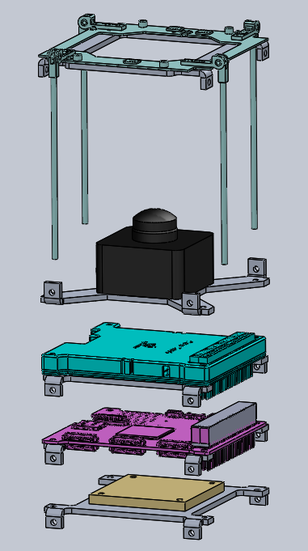
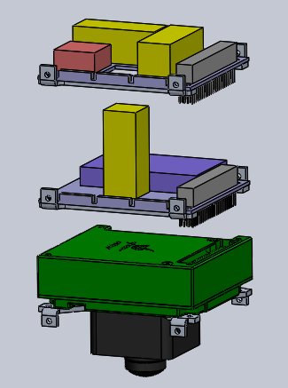
Assembly Strategy
Mount components to mounting plates

Slide 73
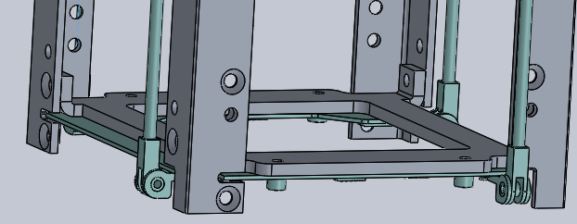
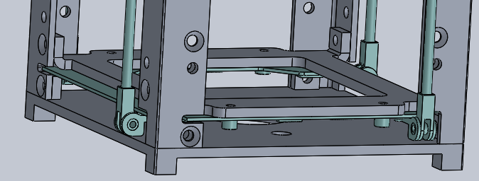
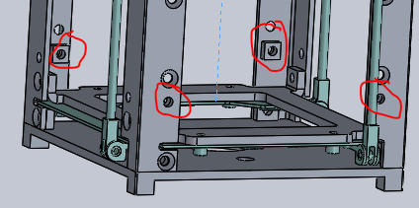
Assembly Strategy
Layer the stack:
Antenna
Cover plate
Prepare bolts

Slide 74
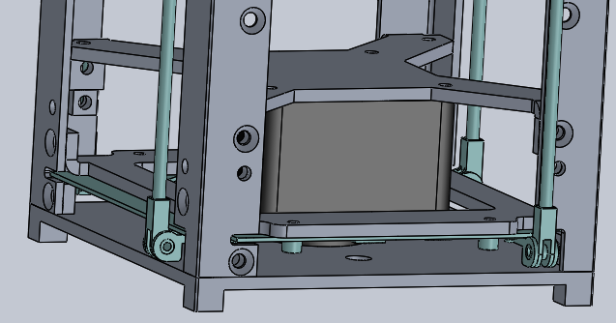
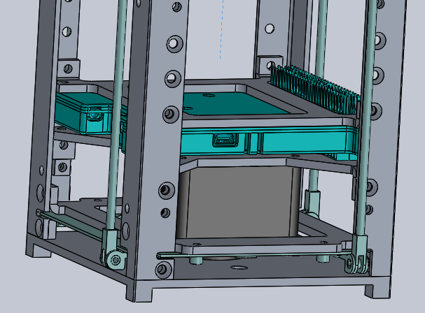
Assembly Strategy
Layer the stack:
Camera
Transceiver

Slide 75
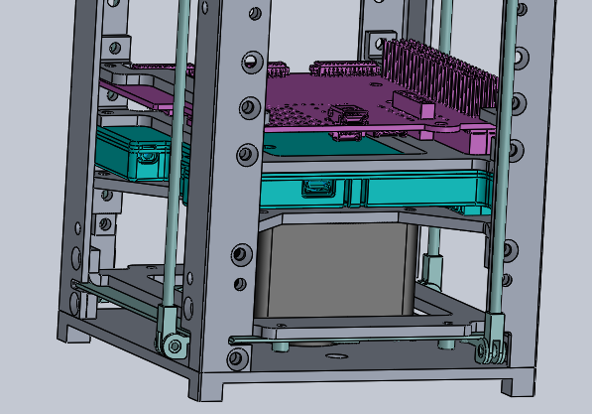
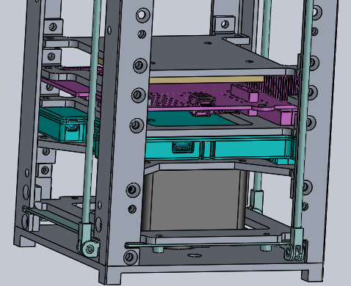
Assembly Strategy
Layer the stack:
OBC
NAC engraving

Slide 76
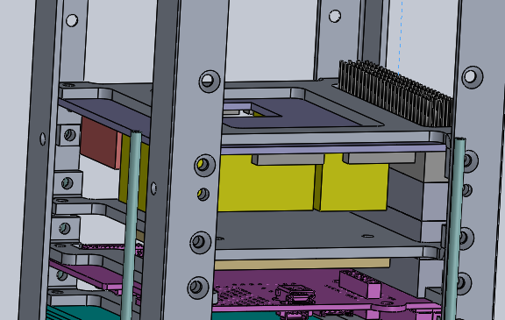
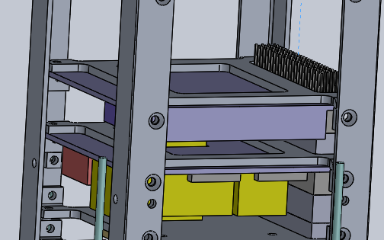
Assembly Strategy
Layer the stack:
Custom Boards
Connectors

Slide 77
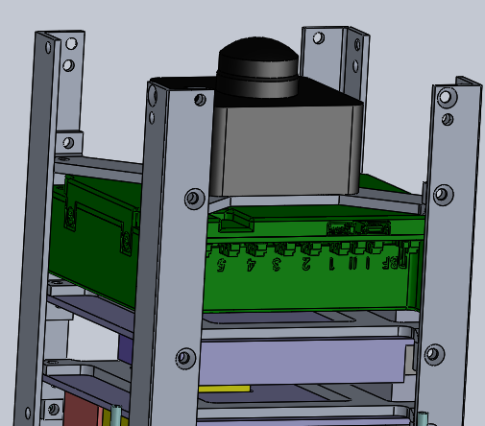

Assembly Strategy
Layer the stack
Camera
Cover plate

Slide 78


Assembly Strategy
Mount the panels
Restrain the antenna

Slide 79
Notes on Assembly
Cover plates to be revised to place GPS antenna cutout at same end as antenna
Actual antenna are longer for 2U
CAD files from 1U antenna

Slide 80
Thermal Analysis
Detailed thermal analysis and testing on this most recent model is subject of a Mechanical and Materials Engineering capstone project
Detailed simulation and testing results expected by March 2020

Slide 81
Break For Lunch

Slide 82
Electrical Power System
Work performed by Stephen Amey, Bryan Southwell, 2018/2019 Capstone Teams
Presented by Stephen Amey

Slide 83
EnduroSat EPS + Batteries

Slide 84
Power Interfaces

Slide 85
EPS – Power generation subsystems
The Endurosat EPS provides Maximum Power Point Tracking (MPPT) via dedicated solar panel connectors.
The Endurosat EPS also provides monitoring and status readouts of each solar panel connected via its USB connector.
The Cubesat batteries are integrated within the Endurosat EPS.

Slide 86
Nominal Power Budget
Subsystem | Component | Power [mW] | Time [h] | Energy [mWh]
COMMS | Transceiver | 82.5 | 0.85 | 70
OBC | On-Board Computer | 700 | 0.85 | 594
ADCS | Magnetorquer x3 | 600 | 0.85 | 509
 | Gyroscope x3 | 12 | 0.85 | 10
Payload | camera x2 | 3000 | 0.00 | 0
EPS | EPS Board | 75 | 0.85 | 64
Power Production | Solar Panels (Production) | 5631 | 0.85 | 4786
 |  | Consumed | + 20% | 1500
 |  | Produced | - 30% | 3350

Slide 87
Transmitting Mode Power Budget
Subsystem | Component | Power [mW] | Time [h] | Energy [mWh]
COMMS | Transceiver | 1362 | 0.15 | 173
OBC | On-Board Computer | 700 | 0.15 | 105
ADCS | Magnetorquer x3 | 600 | 0.15 | 90
 | Gyroscope x3 | 12 | 0.15 | 2
Payload | camera x2 | 3000 | 0.00 | 0
EPS | EPS Board | 75 | 0.15 | 11
Power Production | Solar Panels (Production) | 3940 | 0.15 | 590
 |  | Consumed | + 20% | 457
 |  | Produced | - 30% | 413

Slide 88
Imaging Mode Power Budget
Subsystem | Component | Power [mW] | Time [h] | Energy [mWh]
COMMS | Transceiver | 82.5 | 0.001 | ~1
OBC | On-Board Computer | 700 | 0.001 | ~1
ADCS | Magnetorquer x3 | 600 | 0.001 | ~1
 | Gyroscope x3 | 12 | 0.001 | ~0
Payload | camera x2 | 3000 | 0.001 | 3
EPS | EPS Board | 75 | 0.001 | ~0
Power Production | Solar Panels (Production) | 5631 | 0.001 | 5.6
 |  | Consumed | + 20% | 5.4
 |  | Produced | - 30% | 3.9

Slide 89
Eclipse Power Budget
Subsystem | Component | Power [mW] | Time [h] | Energy [mWh]
COMMS | Transceiver | 82.5 | 0.35 | 29
OBC | On-Board Computer | 700 | 0.35 | 245
ADCS | Magnetorquer x3 | 600 | 0.35 | 210
 | Gyroscope x3 | 12 | 0.35 | 4
Payload | camera x2 | 3000 | 0.00 | 0
EPS | EPS Board | 75 | 0.35 | 26
Power Production | Solar Panels (Production) | 0 | 0.35 | 0
 |  | Consumed | + 20% | 617
 |  | Produced | - 30% | 0

Slide 90
EPS: Inhibits
The kill switch inhibits function similarly to the RBF switch.
The Endurosat EPS provides dedicated connectors for kill switches 1 and 2.
The Endurosat EPS will power up the Cubesat when at least 1 of 2 kill switches is released (along with the RBF switch removed).
The 30-minute delay required for ISS deployments will be handled by a timer circuit that will be activated by the kill switches.

Slide 91

Solar Panel: RBF, Jumpers and Bypass

Slide 92

Solar Panel: RBF, Jumpers and Bypass

Slide 93

Solar Panel: JTAG and OBC Bypass

Slide 94

Solar Panel: JTAG and OBC Bypass

Slide 95

Solar Panel: Accelerometer Bypass

Slide 96

Solar Panel: Accelerometer Bypass

Slide 97
EPS – Inhibits
Once 30 minutes have elapsed, the circuit will then allow the EPS to power up via its kill switch connectors.
If the JMP1 pins are inserted on the solar panel (and thus the EPS as well), the 30-minute timer should be disabled. This allows the Cubesat to be quickly powered up or down for testing via the RBF switch.

Slide 98
EPS –30-minute timer
The 30-minute timer will be an intermediate step between the kill switches and the EPS kill switch connectors.
Upon kill-switch release, the 30-minute timer will begin.
After 30 minutes have elapsed, there will be a ‘closed circuit’ between the two respective pins of the kill-switch connectors.
Once this closed circuit is formed, if the RBF switch has been removed, then the Cubesat will be able to power on.

Slide 99
EPS – RBF
The RBF switch is an audio-jack connector, creating a closed circuit when inserted.
This switch will interface directly with the Endurosat EPS, via its dedicated RBF switch connector. It will not interface with the 30-minute timer.
The functionality of the RBF switch will differ when the JMP1 connector is used. This will disable the self-locking functionality of the EPS, and will power down the Cubesat when the RBF pin is inserted. If JMP1 is not used, inserting the RBF pin WILL NOT power down the Cubesat.

Slide 100
EPS – Jumper pins
The JMP1 and JMP2 connectors of the Endurosat EPS will be exposed via connectors on the solar panels, and provide additional functionality.
The JMP1 connector will – when a closed circuit between the pins is formed – disable the self-locking functionality of the EPS, allowing it the Cubesat to power off when the RBF pin is inserted (whereas if JMP1 is not connected, it will not power off if the RBF pin is inserted).

Slide 101
EPS – Jumper pins
The JMP2 connector – when a closed circuit is formed between the pins – will allow for the batteries of the EPS to be charged via the EPS USB connector.
The EPS USB connector is exposed via the solar panels, and can be used for monitoring and control of the EPS, and charging the batteries when the JMP2 pins are connected together.

Slide 102

EPS – Power generation subsystems – Solar cell layout
The solar cells selected are AZUR SPACE 3G30A solar cell assemblies.
4 solar cells will be used per panel, and with a collection of 4 panels, a total of 16 solar cells will be used.

Slide 103
Solar Panel Assembly: Mounting Components
Electrical testing of all components should be performed and ensure they meet the standards specified in their respective datasheets.
Examine the surface of the PCB for any defects in the panel surface.
Clean the PCB and ensure it is free of debris.
Insert any components that are to lie embedded in the PCB’s surface (USB connectors, RBF switch, etc.) and properly stake them to the PCB.
Mount the photodiode base and antenna release to the PCB.
Mount the appropriate electrical components to the PCB in their designated locations.
Mount the appropriate connectors on the top and bottom sides of the PCB.
Perform testing of all electrical components of the panel thus far (antenna release, sensors, bypasses, RBF switch, solar cell circuit), and ensure they are all working as intended.

Slide 104
Solar Panel Assembly: Preparing the Solar Cells
Inspect the solar cells for defects, cracks, stress marks etc. Set any such cells aside.
Ensure the interconnects are flattened.
Clean the cell and ensure it is free of debris.
Prepare a strip of silver foil.
Bond the strip to the designated location on the bottom-side of the cell (positive terminal) using silver epoxy. The strip should be exposed in the +Z direction of the solar cell.
Allow it to cure at 80°C for 3 hours.
Modify (cut or bend in a triangle shape) the connectors and silver foil to the appropriate lengths as required by the PCB solder points.

Slide 105

Solar Panel Assembly

Slide 106
Solar Panel Assembly: Laying Down Cells
Place the solar cell template on the NuSil tape, and cut around the template with the Exacto blade. Ensure there are no tears. The cutout should cover the entirety of the area given by the template. The template should also allow for venting space around the silver foil connector on the bottom-side of the cell as shown in Figure 28.
Clean the surface of the PCB with solvent and flux remover to ensure there is no debris. Perform the final cleaning with isopropyl alcohol.
Place the cutout of the NuSil tape over the marked position for the solar cell on the PCB to verify that it covers the entire area.
Remove the covering on the NuSil tape that will be attached to the PCB.
Apply the NuSil tape by allowing one tip of the tape to contact the board, then slowly rolling the rest down. Apply pressure to ensure no air is trapped underneath.
Verify that the NuSil tape has been laid down properly. If not, remove it and clean the area, then repeat the application until correct.
Clean the bottom of the solar cell (positive terminal) with isopropyl alcohol and ensure no debris remains.

Slide 107
Solar Panel Assembly: Laying Down Cells
Remove the top covering of the NuSil tape to expose the adhesive.
Allow one tip of the solar cell to contact the adhesive, and slowly lay the cell down to avoid the trapping of air, while NOT applying pressure. Ensure that the cell is properly lined up before attempting, as it cannot be removed afterwards.
Starting at the end initially attached, use a credit card-like material to apply pressure and move towards the other side to attempt to remove any trapped air.
Inspect the bond to ensure it is complete and that there are no air bubbles present.
Trim any excess NuSil tape with the Exacto blade.
Repeat for the remainder of the solar cells.
Upon application of the final cell, perform testing to ensure the energy output of the solar panel meets the specified values.

Slide 108
EPS – Test plan and test specifications
Develop the test plan and test specifications of the electrical subsystems
Testing plans in place for the solar panels as they are built. Their final tests are ensuring sensor circuits work as expected, and that it produces the specified max power under a known intensity.
Other tests should include EPS/OBC USB bypass, EPS jumpers, self-lock disable, and charging. Also include accelerometers, since all of these are on the solar panels.

Slide 109
Attitude Determination and Control System
Work performed by Andrew Ning, 2018/2019 Capstone Teams
Work presented by Andrew Ning

Slide 110
Nominal Attitude Configuration
Camera payload and UHF communications do not impose strict pointing requirements
Coarse pointing towards sun for power generation

Slide 111

ADCS Hardware Suite
Sensors
Photodiodes (22)
Solar Panels (4)
3-Axis Magnetic Compass (1)
3-Axis Gyroscope (1)
Temperature Sensors
Actuator
3-Axis Magnetic Torque Rods

Slide 112

Attitude Determination Overview

Slide 113

Translation of Sensor Input to Usable Information
Photodiodes/Solar Panels
Sun sensors proven to be too costly
Sun sensor functionality will be fulfilled by photodiodes and solar panels

Slide 114
Translation of Sensor Input to Usable Information
3-Axis Magnetic Compass
Measures Earth magnetic field in body frame
Earth magnetic field in inertial frame given by World Magnetic Model
3-Axis Gyroscope
Measures angular velocity in body frame
Integrated for angular distance (used when neither photodiode nor magnetic field information is available

Slide 115



State Estimation
State estimation done with Multiplicative Extended Kalman Filter (MEKF)
Modified to be iterative in the form of a sequential MEKF (SMEKF)
State Vector
Attitude Error
$$\left[\begin{aligned}\begin{matrix}{δρ}_{3×1} \\ β_{3×1} \\ C_{m×1}\end{matrix} \\ α_{m×1} \\ ε_{m×1}\end{aligned}\right]$$
Parameterized with Gibbs Error Vector
Gyroscope Bias
Bias along each axis
Photodiode/Solar Panel Calibration Factor
Measure of $C=\frac{E_{AM0}I}{E_{Cal}}$
Photodiode Normal Vectors
Parametrized with azimuth ($α$) and elevation ($ε$) angles

Slide 116



Albedo Filter
Filtering of albedo is done through the MEKF
Calibration factor also fulfills purpose of in-orbit photodiode calibration
Incoming light assumed to be in form of:
$$i_{measured}=i_{Sun}+ i_{Earth}$$
$$i_{Sun}=C{\left\{E_{Am0}n_{s}∙{\hat{r}}_{Sun}\right\}}_{0}^{∞}$$
$$i_{Earth}=C{\left\{E_{Earth}n_{s}∙{\hat{r}}_{Sun}\right\}}_{0}^{∞}$$
Measurement Matrix (Photodiode/Solar Panel Input)
$$h\left(x_{k}\right)=C_{p}n_{p}\left(A\left(q\right)s\right)+C_{p}\frac{E_{Earth}\left({A\left(q\right)n}_{p}\right)}{E_{AM0}}, s=Inertial Sun Vector \\ A=Rotation Matrix parameterized by Attitude Quaternion$$
Sensitivity Matrix (Photodiode/Solar Panel Input)
$$H\left(x_{k}\right)=\left[\frac{∂I_{p}}{∂δρ} 0_{1×3} \frac{∂I_{p}}{∂C} \frac{∂I_{p}}{∂α} \frac{∂I_{p}}{∂ε}\right]$$

Slide 117

Albedo Model
Reflectivity data based on NASA Total Ozone Mapping Spectrometer (TOMS)
Earth irradiance for each cell modeled as:
$$E_{c}\left(φ,θ\right)=\frac{ρ\left(φ,θ\right)E_{AM0}A_{c}(φ){(r}_{Sun}∙n_{c})(r_{Sat}∙n_{c})}{π\left\|r_{Sat}\right\|}$$
$A_{c}(φ)$ is the area of each cell (calculated using surface integral)
$r_{sun}$ and $r_{Sat}$ are position vectors calculated with GPS readings
$ρ(φ,θ)$ is the reflectivity of cell with latitude $φ$ and longitude $θ$ taken from TOMS data
Calculated for cells visible by both Sun and satellite

Slide 118
MEKF Initialization
The internal attitude reference is initialized using TRIAD
Reference-Measurement Pairs
Sun Vector
Body Frame: Vector created from photodiode/solar panel input
Inertial Frame: Vector created from Sun and CubeSat position in inertial frame
Magnetic Field Vector
Body Frame: Magnetic field vector measured with 3-axis magnetic compass
Inertial Frame: Magnetic field vector modeled using World Magnetic Model based on current CubeSat position

Slide 119


Attitude Determination Performance
Preliminary attitude determination design is modeled in MATLAB
Attitude error settles to average error of 2.86 degrees over 1 to 2 minute period
Performance can be improved with better tuning
Performance meets attitude requirements but can be improved with better tuning of parameters

Slide 120
Attitude Control Overview
Detumbling is accomplished with B-dot control law
Large angle maneuvers are accomplished with PD control
Special situations in which angular velocity is large is mitigated with B-dot control law as well

Slide 121

Attitude Control: Orbit Insertion
A B-dot bang-bang controller variant is used that produces a magnetic moment of
$$m=−m_{max}sgn(b)$$
Preliminary results indicate approximate time of 4 orbital periods (8 hours) to reduce angular rate from 5 degrees per second in each axis to less than 0.1 degrees per second in each axis

Slide 122

Attitude Control: Orbit Insertion

Slide 123

Attitude Control: Slew
Large angle maneuvers done with PD control using eigenaxis rotation for shortest path
Control torque vector given by:
$$u=−ΩJw−Dw−Kq_{e}$$
Where$Ω$ is the skew-symmetric matrix
J is the inertia matrix of the CubeSat
D and K are constant gain matrices
$q_{e}$ is the error vector between initial and desired attitude

Slide 124

Attitude Control: Slew
Preliminary results indicate average of 15 seconds to perform re-orientation with error of less than 2-5 degrees achievable depending on tuning parameters
Performance is improvable with implementation of more robust controllers such as PID and $H_{∞}$

Slide 125


Attitude Control: Slew

Slide 126
Command and Data Handling
Work done by Alexis Pascual, 2018/2019 Capstone Teams
Work presented by Stephen Amey

Slide 127

Command and Data Handling System
Hardware Configuration
Endurosat OBC
ARM Cortex M4 (180Mhz)
2MB Program Memory Size, 256kB RAM, 2MB Flash Memory
SD Card Mount
JTAG port for umbilical interfacing during AIT Phase
PC 104 Connector
Picoblade - 12 Pin connector
TLE-110-01-G-DV – 20 Pin Connector
Molex 53398-0471 – 4 Pin connector

Slide 128
Command and Data Handling System
Interfaces
Component | Protocol | Physical Pin Connection
EPS Board Data | UART | PC104 (H1: 39, 40)
Solar Panels | SPI | 12 Pin (PAN: 5,6,9,10)
Transceiver | UART | PC104 (H1: 33, 35)
Gyroscope | SPI | 12 Pin (PAN: 5,6,9,10)
Magnetorquer | PWM | 12 Pin (PAN: 1,2)
Payload | USB | USB/P1

Slide 129
Command and Data Handling System
Bootloader Philosophy
Bootloader must be able to load the appropriate program image into the program memory.
Bootloader must be able to check integrity of program memory as well as RAM
Bootloader must be able to recover from software faults
Bootloader must be able to communicate with the ground station to receive updated program image packets
Bootloader must be able to assess the integrity of each packet before writing them into the flash memory
Bootloader must be able to assess the integrity of the whole program image
Bootloader must be able to write the program image into the program memory
Bootloader must be able to jump into the program memory to begin operations

Slide 130

Command and Data Handling System
Bootloader Philosophy

Slide 131

Command and Data Handling System
Bootloader Philosophy

Slide 132

Command and Data Handling System
Bootloader Philosophy

Slide 133

Command and Data Handling System
Bootloader Philosophy

Slide 134
Command and Data Handling System
Software Development Approach
Software will be developed on top of FreeRTOS
Language: C
RTOS Tasks and function calls will be designed around operation modes.
OBC by default will be on Nominal Mode, and background functions will monitor sensor outputs and command queues.
Interrupt Service Routines will be executed based on sensor output threshold and time-tagged commands.
Task priorities have are yet to be determined.

Slide 135



Command and Data Handling System
Software Development Approach

Slide 136


Command and Data Handling System
Software Development Approach

Slide 137



Command and Data Handling System
Software Development Approach

Slide 138

Command and Data Handling System
Prototyping Boards
Nucleo F429ZI
STM32 MCU
Cortex M4 (180Mhz)
192KB RAM
UART: 6
SPI: 5
Analog Input: 19
Flash Memory: 2MB
FreeRTOS capable

Slide 139
Command and Data Handling System
Prototyping Boards
One prototyping board will be used to develop bootloader and flight software.
The other prototyping board will be used to create a tester which will simulate sensors and other subsystems.
Tester will monitor flight software responses to sensor/subsystem input

Slide 140

Command and Data Handling System
Estimated Processing Load
Tests conducted to simulate the most resource intensive task using 3 Nucleo-F429ZI prototyping boards
Image of size 13.5MB was successfully passed from the “camera” to the OBC over UART
Image was then deconstructed and passed over to the “transceiver” module over UART
Image was successfully reconstructed by the “transceiver” module

Slide 141
Command and Data Handling System
Estimated Processing Load
The tests prove that the hardware configuration (i.e. CPU, RAM, I/O) can handle the most resource intensive task of receiving an image from the camera and passing it to the transceiver module.
Additional tests need to be conducted to determine CPU time, power consumption, and memory allocation for all operating modes.
Future tests include adding a transmitter module on the prototyping boards to simulate actual operations

Slide 142
AIT
Presented by Nick Mitchell

Slide 143
AIT
EGSE:
Multimeters
Power Supplies
SDR MegaBee for rapid prototyping
Oscilloscopes
Network Analyzer
Spectrum Analyzer
Waveform Generators
Microscopes
Soldering stations (with multiple tips and necessary equipment from CSA workshop)

Slide 144

AIT
Goal: Design the equipment and software needed to test a CubeSat / FlatSat with little human interaction.

Slide 145
AIT
Testing:
Acknowledged that antenna release mechanism testing is critical*
It also has moving parts and will require some human interaction for verification that it will NOT damage the surrounding components.
Heavy emphasis on testing starting mechanism when designed for maximum safety assurance*
The other components will be designed to be modularly tested.

Slide 146
AIT
Red = Will Become Flight Hardware
Black = Can be cheaply prototyped (not flight hardware right away)

Slide 147

AIT
EGSE:
SDR Transceiver (USRP B210 if available)
SDR Transceiver (MegaBEE cube)
70MHz-6GHz
56MHz bandwidth per channel
23dBm output Power
-94dBm receiver sensitivity level
Software: HDL,Matlab/Simulink,C/C++/Python
USB V2.0 connection
SMA antenna connectors
FREE, Already in lab (good for rapid prototyping)
Notes:
Note that the USRP is going to be purchased but that will not stop our prototyping! I have asked jayshri and we are able to make use of the MegaBEE cube that we have in lab (we have other SDR’s as well)

Slide 148
AIT
CubeSat Test Plan:
Safety and Handling Procedures:
BBM:
Summer student work 2019 + Capstone 2018 prelim
Demonstration model:
FlatSat
Structural and Thermal Model:
Bus redesigned, Need to do another thermal + vibe test
Proto-Flight Model:
FlatSat will turn into it
Flight Model:
From Proto-Flight Model

Slide 149
AIT
People Resources:
CubeSat Club members during the year.
Will be started this year!!
Safety training, bringing up to speed on project
Assembly and Integration training
Extra hands on demonstration model under team leads
Capstone Teams:
Structural and Thermal model
Groundstation design
PCB Design for custom boards
Including inspection protocols, manufacturing plan and testing plan

Slide 150
AIT
People Resources:
Team Leads:
Individual subsystems
Develop a detailed testing plan if not done already.
Summer Students(2019):
Documentation is done (Github and Sharepoint)
Assembly instructions for CubeSat bus
Assembly instructions for assembling solar panels

Slide 151
AIT
Still to do:
EMI testing plan, requirements and procedure
Identify resources required
Custom board design + testing
Request For Deviation form for early turn on of camera
Timer circuit based on above decision
Antenna release mechanism and testing
Operations protocols and training with CubeSat club students

Slide 152
AIT
Laboratory Environments for Spacecraft Assembly:
What class of clean room necessary?
Is air handling necessary?
Options for rooms:
Thomson Engineering Building room 6
Optics Lab Spencer Engineering Building room 3025A
Western NanoFabrication Facility

Slide 153
Programmatics
Outreach Update
Status Updates
Budget Update
Risk Assessment

Slide 154
Outreach Updates
Revised plans with NAC
Institute for Earth and Space Exploration (Western Space)
CubeSat Club
Space Business Case Competition
Educational Kits

Slide 155
Budget Update
Current procurement estimates in line with budget
To-date prototyping in line with budget
Nunavut travel re-aligned for more frequent travel of Western members to NAC

Slide 156
Status Updates
1St draft of SDP and BOM to CSA
RF Comms licencing pending
RSSSA licencing pending

Slide 157
Programmatic Risk Assessment
Risk ID | Description | Impact | Probability | Status Entry Date
1 | Cost of prototyping more than budgeted | 2 | 4 | January 10, 2019
2 | Cost of flight model more than budgeted | 4 | 3 | January 10, 2019
3 | HQP turnover leads to gaps in experience and capability | 4 | 4 | January 10, 2019
Notes:
Matt B?

Slide 158
Programmatic Risk Assessment
Programmatic Risk Matrix
LIKELIHOOD | 5
 | 4 |  | 1 |  | 3
 | 3
 | 2 |  |  |  | 2
 | 1
 |  | 1 | 2 | 3 | 4 | 5
 |  | IMPACT
Notes:
Matt B?

Slide 159
Technical Risk Assessment
Risk ID | Description | Impact | Probability | Status Entry Date
1 | UHF Communication Licensing | 5 | 2 | January 10, 2019
2 | Earth Observation Licensing | 3 | 3 | January 10, 2019
3 | Payload Camera | 5 | 1 | January 10, 2019
4 | Solar Panels assembly | 5 | 3 | January 10, 2019
5 | Ground Station Development | 3 | 3 | January 10, 2019
6 | Antenna Deployment Development | 5 | 2 | October 10, 2019
7 | Deployment Switch / Circuit Development | 5 | 2 | October 10, 2019
8 | Magnetorquer Development | 2 | 3 | October 10, 2019
9 | Software Development | 4 | 3 | October 10, 2019
Notes:
Matt B?

Slide 160
Technical Risk Assessment
Technical Risk Matrix
LIKELIHOOD | 5
 | 4
 | 3 |  | 8 | 2,5 | 4,9
 | 2 |  |  |  |  | 1, 6 ,7
 | 1 |  |  |  |  | 3
 |  | 1 | 2 | 3 | 4 | 5
 |  | IMPACT
Notes:
Matt B?

Slide 161








Thank you

